Slide 1


Slide 2

6
ECONOMIC GROWTH
Notes:
Notes and teaching tips: 11, 16, 18, 32, 37, 43, 45, 46, 48, 49, 51, 55, 62, and 63.
To view a full-screen figure during a class, click the expand button.
To return to the previous slide, click the shrink button.
To advance to the next slide, click anywhere on the full screen figure.
Applying the principles of economics to interpret and understand the news is a major goal of the principles course. You can encourage your students in this activity by using the two features: Economics in the News and Economics in Action.
(1) Before each class, scan the news and select two or three headlines that are relevant to your session today. There is always something that works. Read the headline and ask for comments, interpretation, discussion. Pose questions arising from it that motivate today’s class. At the end of the class, return to the questions and answer them with the tools you’ve been explaining.
(2) Once or twice a semester, set an assignment, for credit, with the following instructions:
(a) Find a news article about an economic topic that you find interesting.
(b) Make a short bullet-list summary of the article.
(c) Write and illustrate with appropriate graphs an economic analysis of the key points in the article.
Use the Economics in the News features in your textbook as models.

Slide 3
After studying this chapter, you will be able to:
Define and calculate the economic growth rate and explain the implications of sustained growth
Describe the economic growth trends in Canada and other countries and regions
Explain what makes potential GDP grow
Explain the sources of labour productivity growth
Explain the theories of economic growth and policies to increase its rate
Copyright © 2019 Pearson Canada Inc.

Slide 4
The Basics of Economic Growth
Economic growth is the sustained expansion of production possibilities measured as the increase in real GDP over a given period.
Calculating Growth Rates
The economic growth rate is the annual percentage change of real GDP.
The economic growth rate tells us how rapidly the total economy is expanding.

Slide 5
The Basics of Economic Growth
The standard of living depends on real GDP per person.
Real GDP per person is real GDP divided by the population.
Real GDP per person grows only if real GDP grows faster than the population grows.

Slide 6
The Basics of Economic Growth
Economic Growth Versus Business Cycle Expansion
Real GDP can increase for two distinct reasons:
The economy might be returning to full employment in an expansion phase of the business cycle.
Potential GDP might be increasing.
The return to full employment in an expansion phase of the business cycle isn’t economic growth.
The expansion of potential GDP is economic growth.

Slide 7
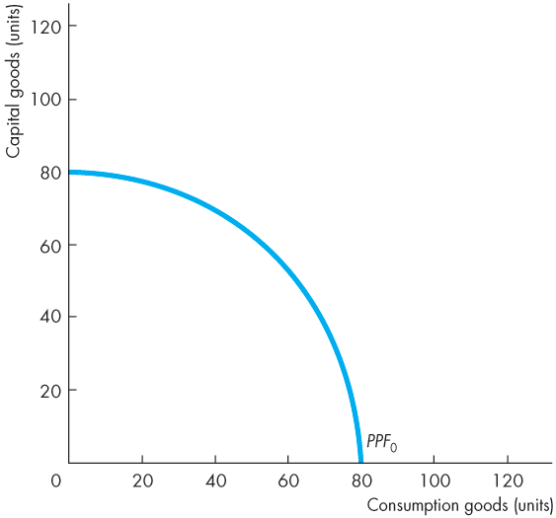
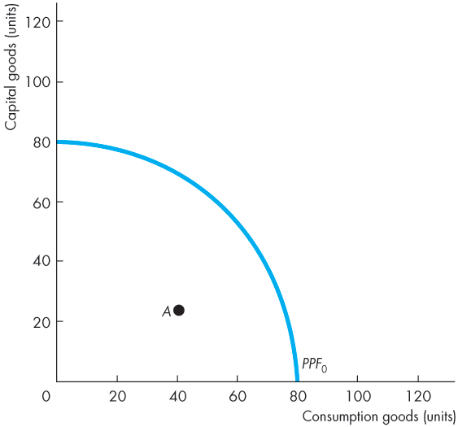
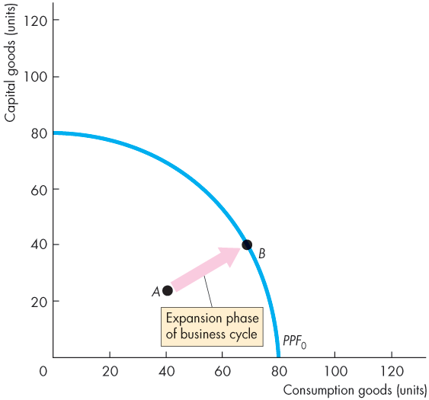
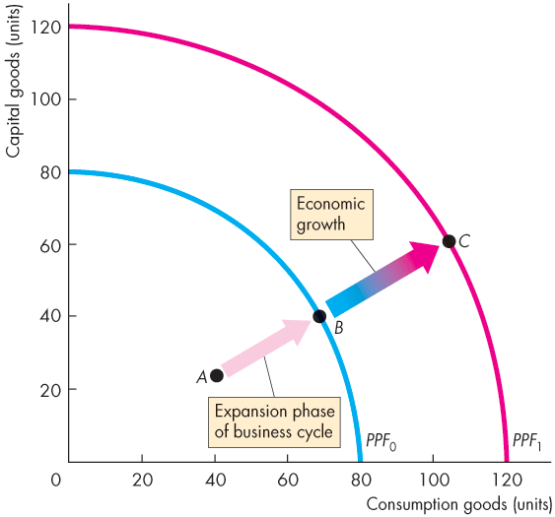

The Basics of Economic Growth
Figure 6.1 illustrates the distinction.
A return to full employment in an expansion is a movement from inside the PPF (point A) to a point on the PPF (point B).
Economic growth is the outward shift of the PPF from PPF₀ to PPF₁ and the movement from point B on PPF₀ to point C on PPF₁.

Slide 9
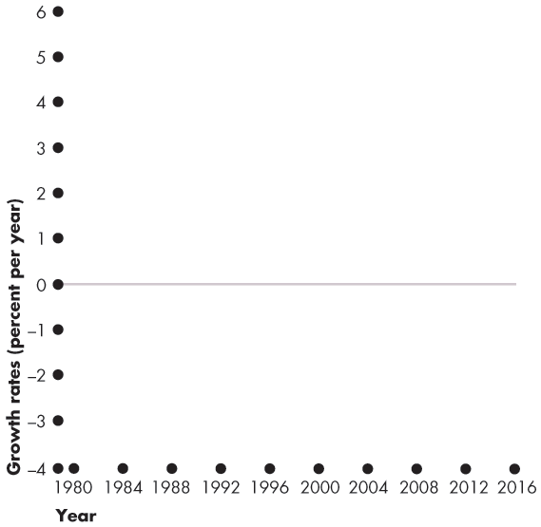
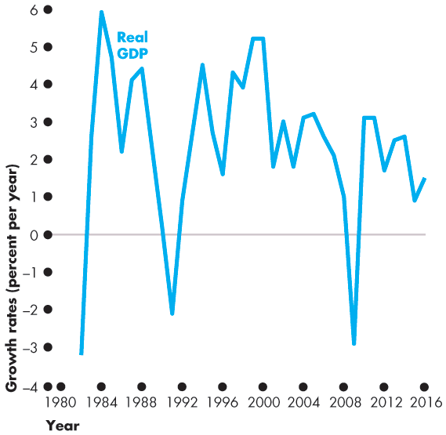
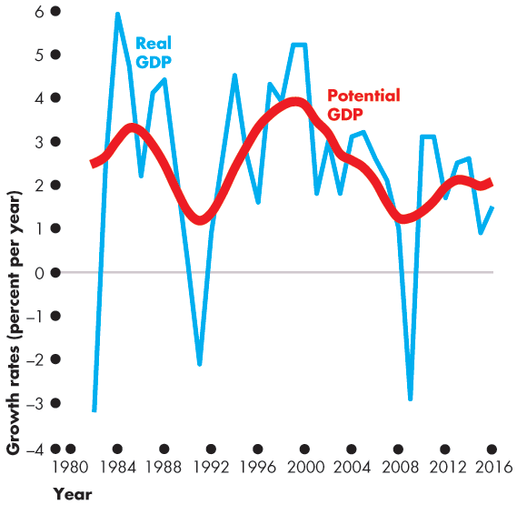
The Basics of Economic Growth
The figure shows the growth rate of real GDP.
The growth rate of potential GDP measures the pace of expansion of production possibilities and …
smoothes out the business cycle fluctuations in the growth rate of real GDP.

Slide 11
The Basics of Economic Growth
The Magic of Sustained Growth
The Rule of 70 states that the number of years it takes for the level of a variable to double is approximately 70 divided by the annual percentage growth rate of the variable.
Notes:
Compound Interest You can reinforce the importance of economic growth by relating the fact that if real GDP per person had grown just 0.25 percentage points faster between 1960 and the present, every household today, on average, would have almost $12,000 more income (every person would have $4,500 more). If real GDP per person had grown 1 percentage point faster between 1960 and the present, every household today, on average, would have $50,000 more income (every person would have $21,200 more).To make concrete just how much better off we would have been, get the students to list what they would buy with an extra $21,200 a year.

Slide 12
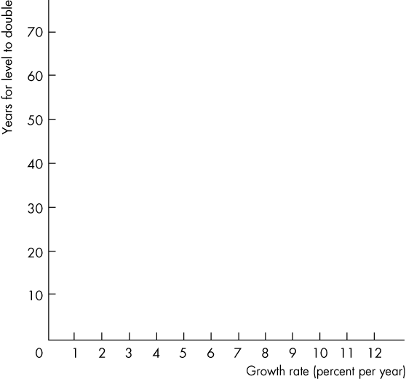
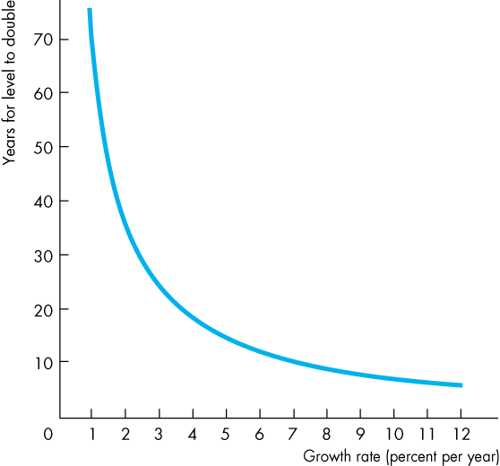
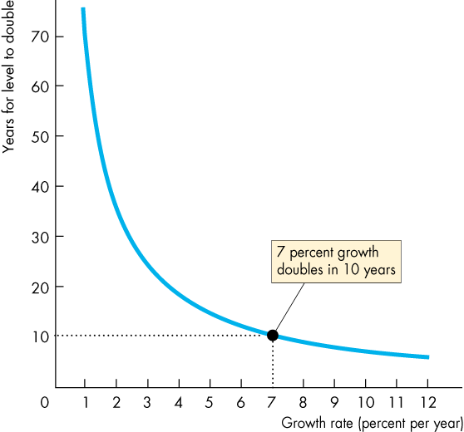
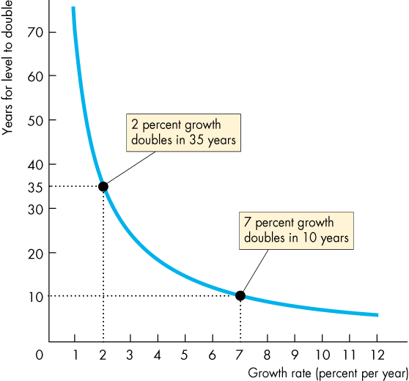
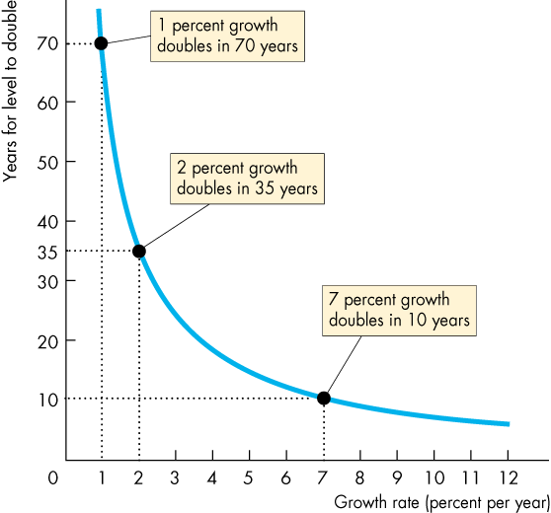
The Basics of Economic Growth
Applying the Rule of 70
Figure 6.3 shows the doubling time for growth rates.
A variable that grows at 7 percent a year doubles in 10 years.
A variable that grows at 2 percent a year doubles in 35 years.
A variable that grows at 1 percent a year doubles in 70 years.

Slide 14
Long-Term Growth Trends
Growth in the Canadian Economy
From 1926 to 2016, growth in real GDP per person in Canada averaged 2 percent a year.
Real GDP per person fell precipitously during the Great Depression and rose rapidly during World War II.
Growth was most rapid during the 1960s.
Growth slowed during the 1970s and sped up again in the 1980s and1990s.
Figure 6.4 on the next slide illustrates.

Slide 15
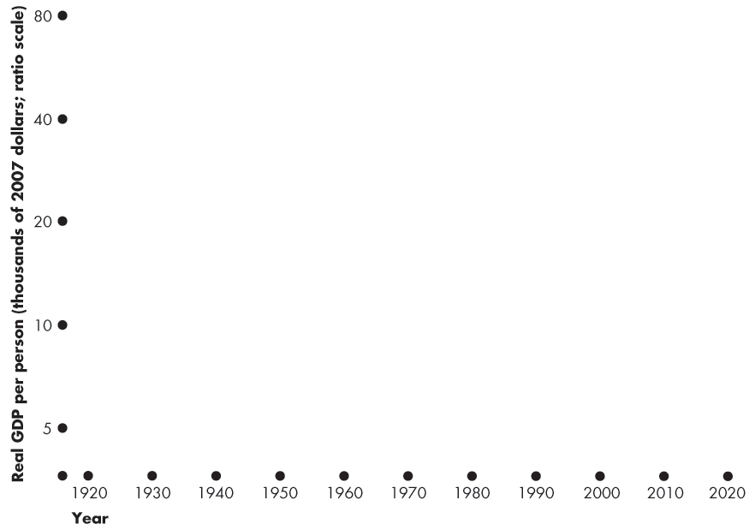
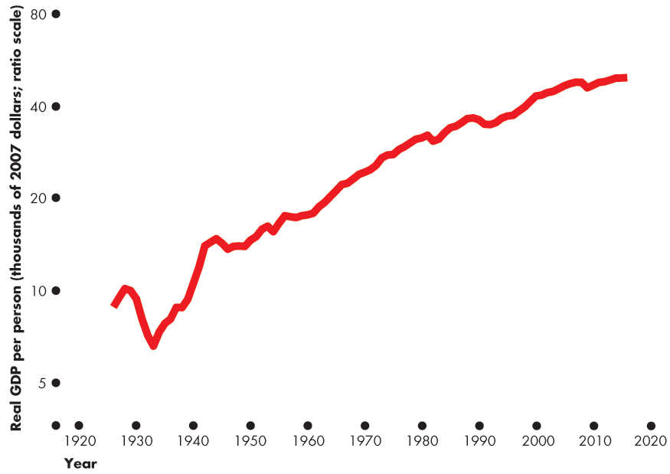
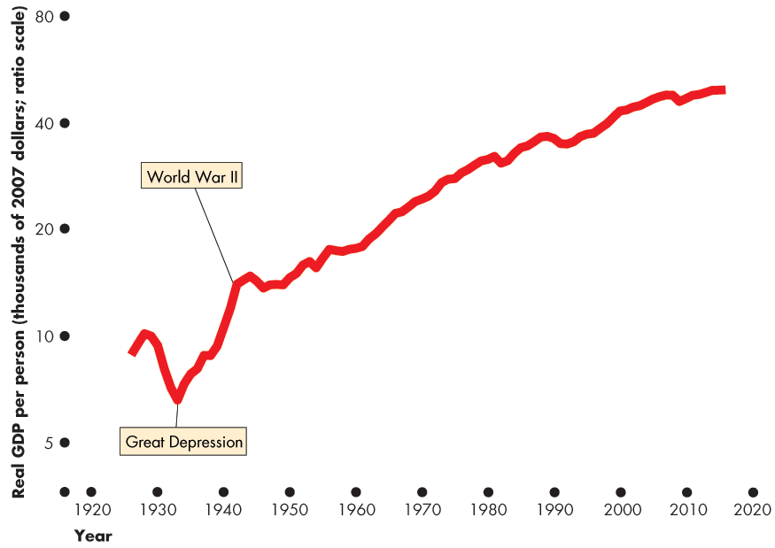
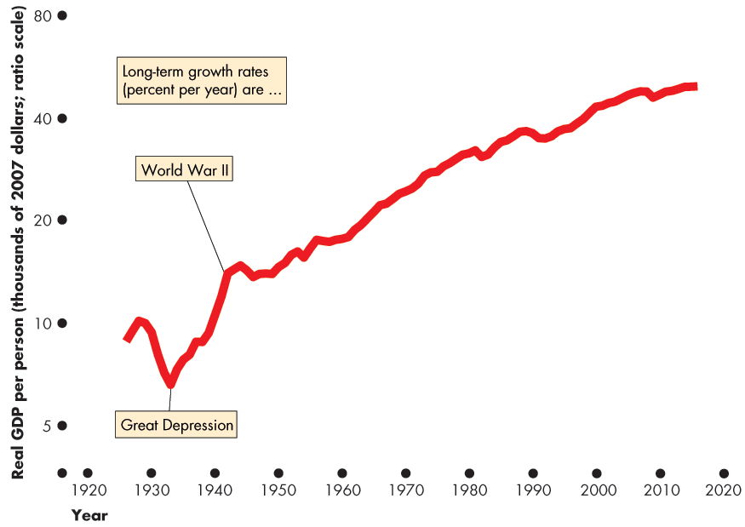
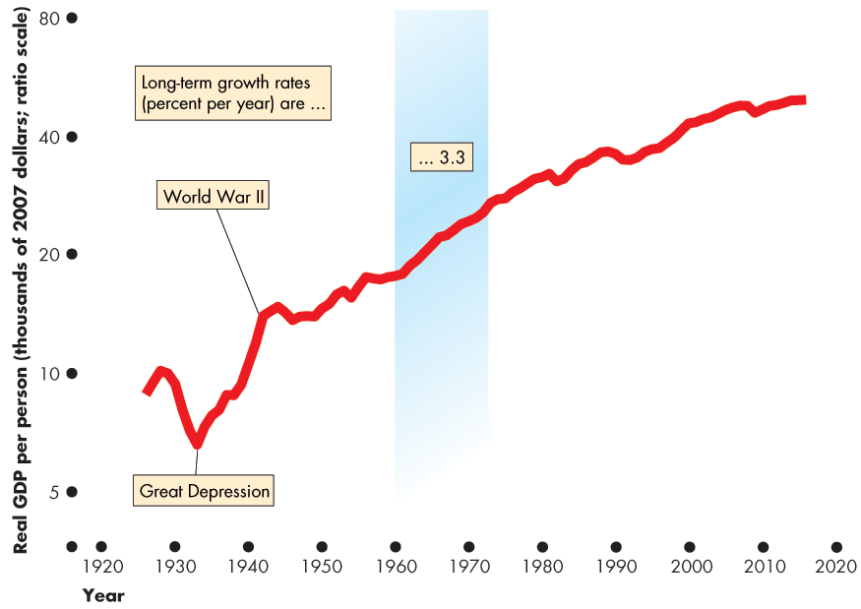
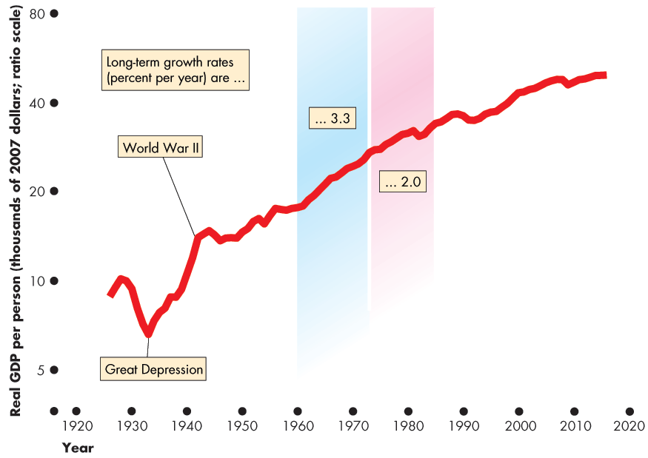
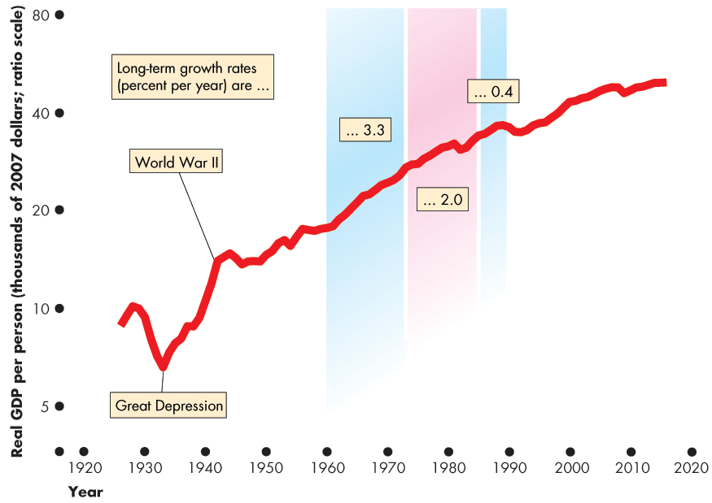
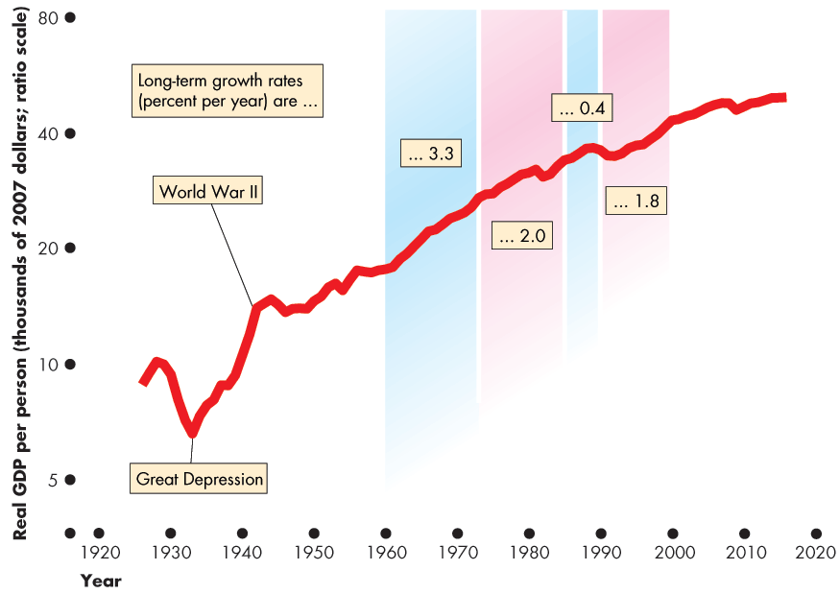
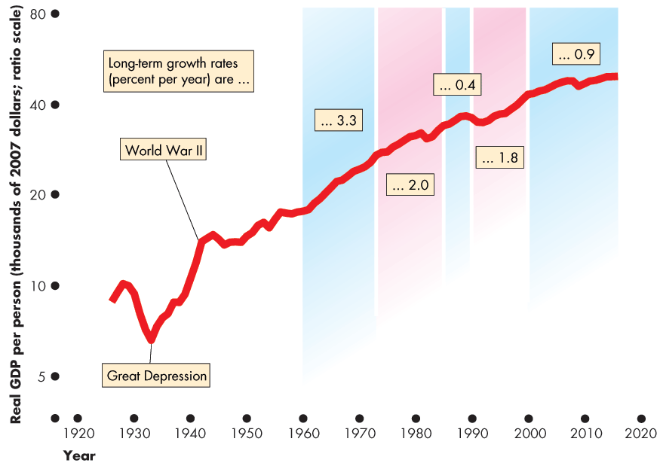

Slide 16
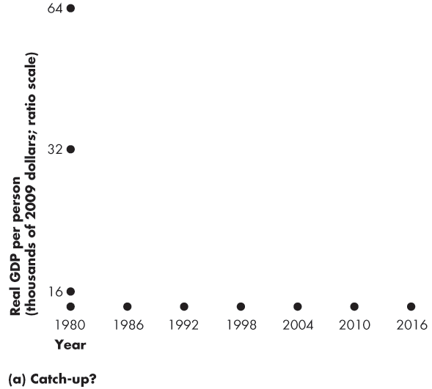
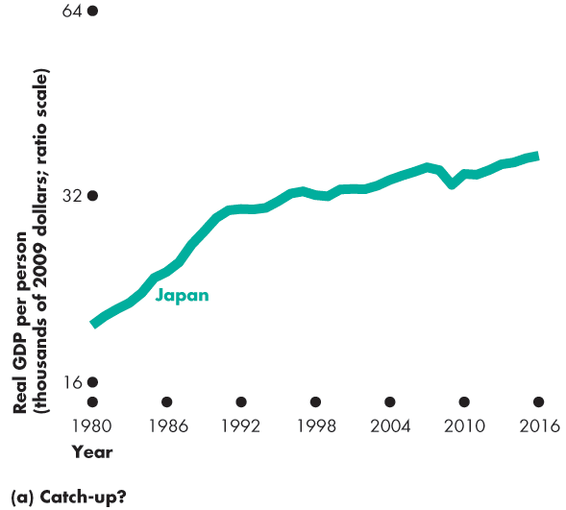
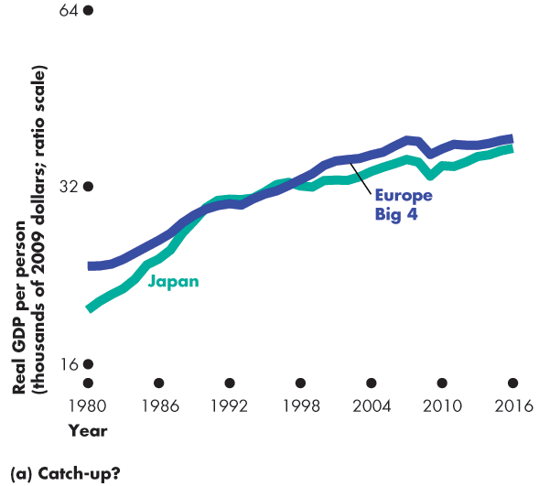
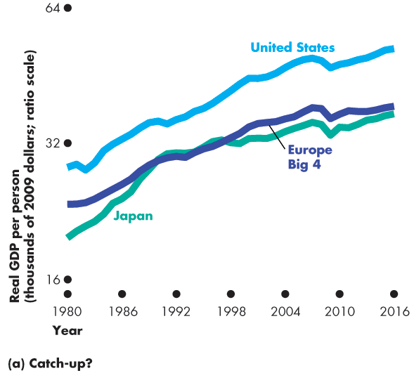
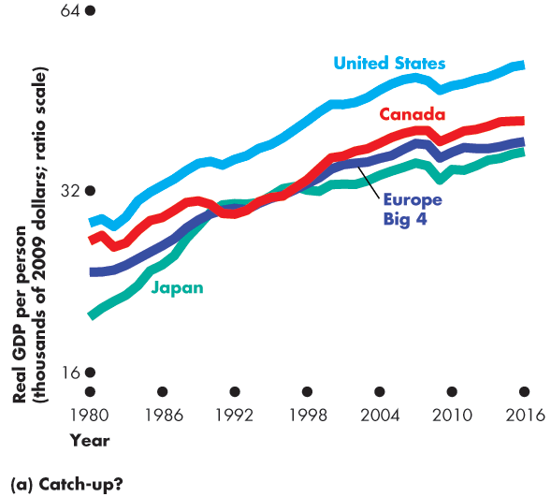
Long-Term Growth Trends
Real GDP Growth in the World Economy
Figure 6.5(a) shows the growth in the rich countries.
Japan grew rapidly in the 1960s, slower in the 1980s, and even slower in the 1990s.
Growth in Europe Big 4, the United States, and Canada has been similar.
Notes:
Is there convergence or divergence in standards of living? What is the role of economic growth for economic inequality? These are highly controversial questions. Most anti-globalization activists treat it as incontrovertible that economic growth creates higher inequality. But this view is likely incorrect.
First, there has been a general convergence of standards of living over the past 50 years. This fact is in part the result of economic growth in China with a population that accounts for close to one-fifth of humanity.
Second, while some nations have fallen behind, those less-developed countries that have grown fastest are those that have been most involved in “globalization” by becoming more integrated into global markets for goods and capital.
The policy suggestions of the anti-globalization movement, such as reducing foreign trade and international capital mobility or even abandoning capitalism, property rights, and markets are the policies that are currently most practiced in countries that have grown the slowest. This result might not be a coincidence.

Slide 18
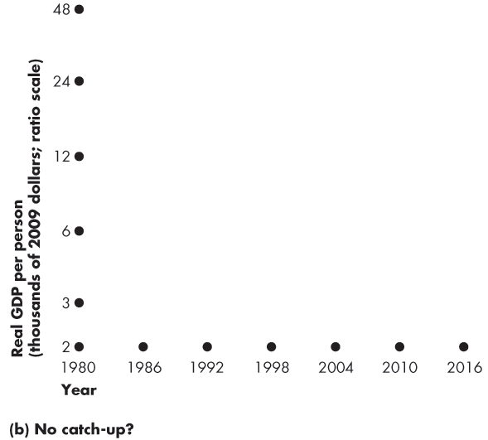
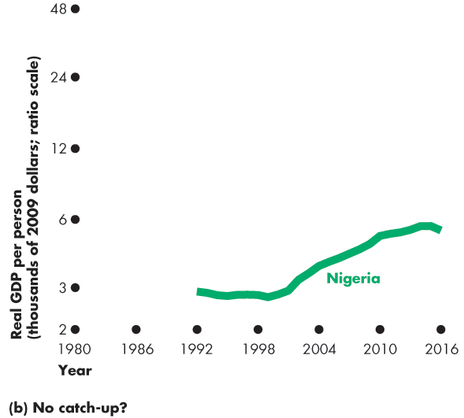
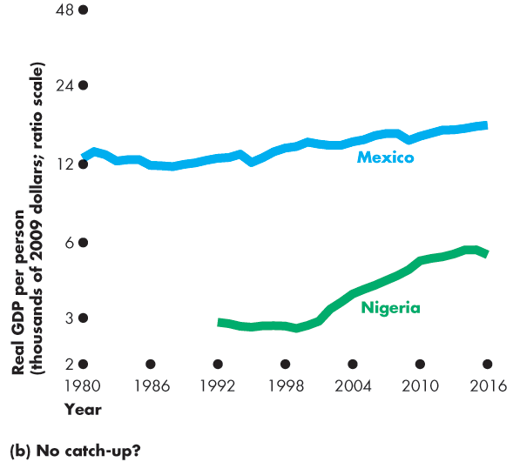
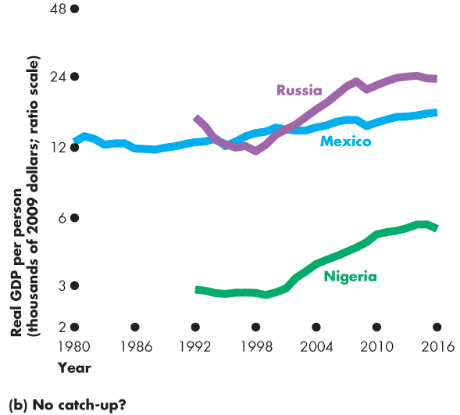
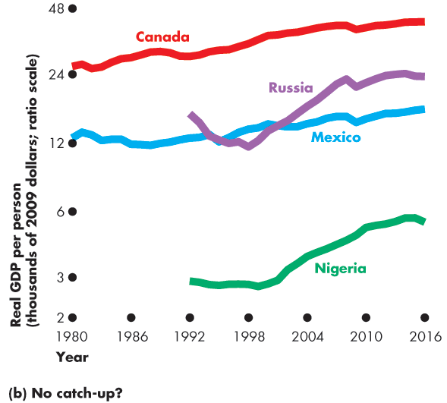

Long-Term Growth Trends
Figure 6.5(b) shows the growth of real GDP per person in group of poor countries.
The gaps between real GDP per person in Canada and in these countries have widened.
Notes:
Classroom activity
Check out Economics in Action: Fast Trains on the Same Track

Slide 20
How Potential GDP Grows
Economic growth occurs when real GDP increases.
But a one-shot increase in real GDP or a recovery from recession is not economic growth.
Economic growth is the sustained, year-on-year increase in potential GDP.

Slide 21
How Potential GDP Grows
What Determines Potential GDP?
Potential GDP is the quantity of real GDP produced when the quantity of labour employed is the full-employment quantity.
To determine potential GDP we use a model with two components:
An aggregate production function
An aggregate labour market

Slide 22
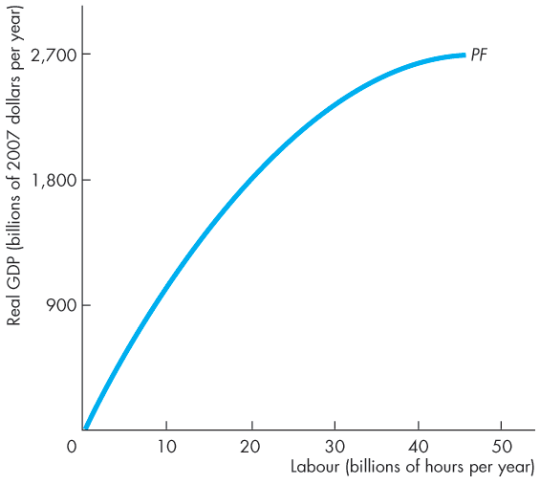
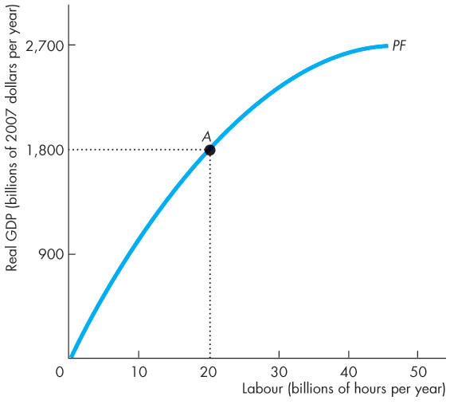
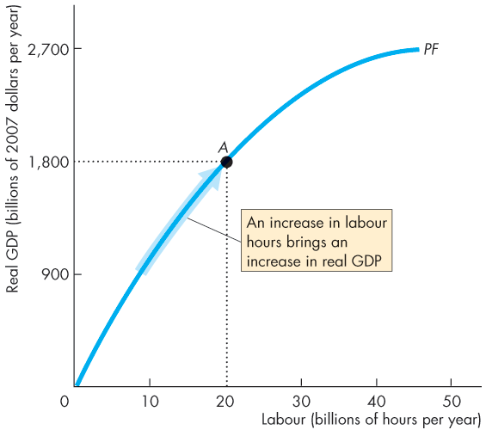

How Potential GDP Grows
Aggregate Production Function
The aggregate production function tells us how real GDP changes as the quantity of labour changes, other things remaining the same.
An increase in labour increases real GDP.

Slide 24
How Potential GDP Grows
Aggregate Labour Market
The demand for labour shows the quantity of labour demanded and the real wage rate.
The real wage rate is the money wage rate divided by the price level.
The supply of labour shows the quantity of labour supplied and the real wage rate.
The labour market is in equilibrium at the real wage rate at which the quantity of labour demanded equals the quantity of labour supplied.

Slide 25
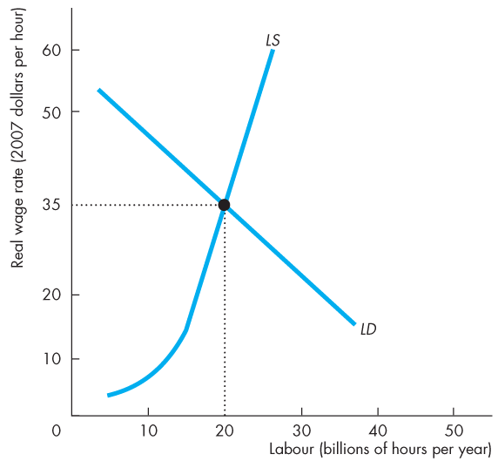
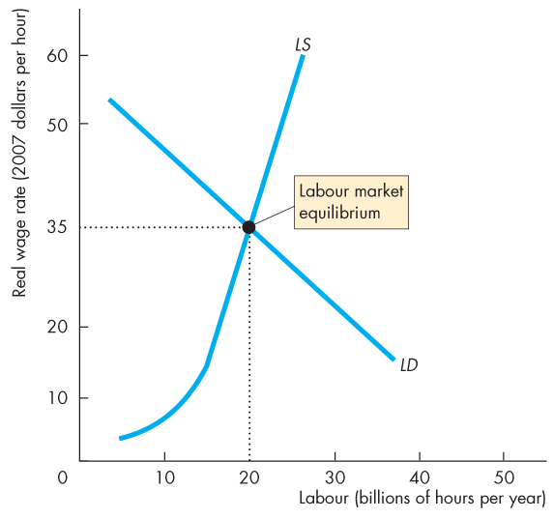
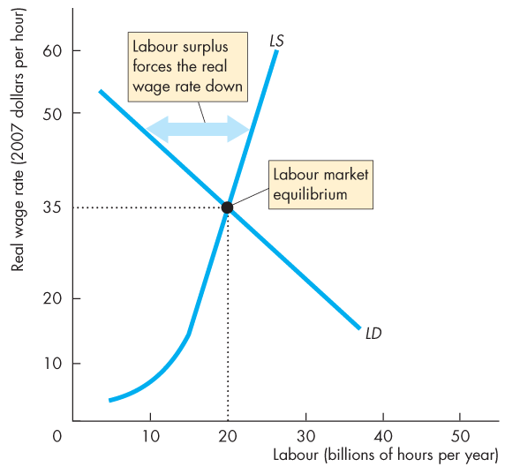
How Potential GDP Grows
Figure 6.7 illustrates labour market equilibrium.
Labour market equilibrium occurs at a real wage rate of $35 an hour and 20 billion hours employed.
At a real wage rate above $35 an hour, there is a surplus of labour and the real wage rate falls.

Slide 26
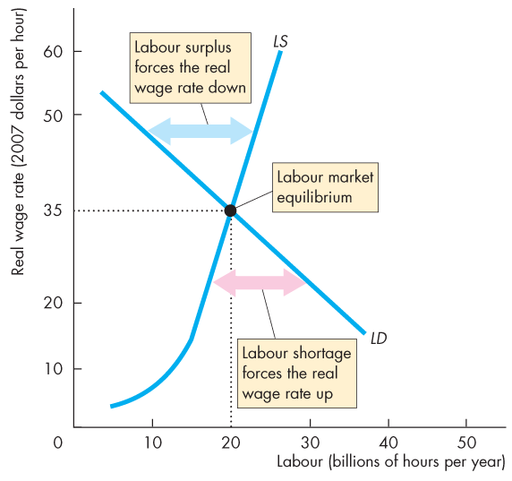

Slide 27
How Potential GDP Grows
At a real wage rate below $35 an hour, there is a shortage of labour and the real wage rate rises.
At the labour market equilibrium, the economy is at full employment.

Slide 28
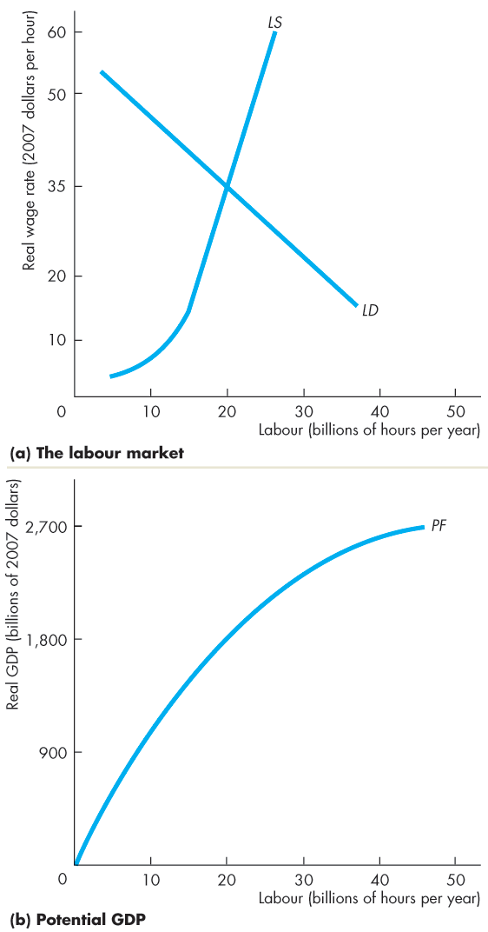
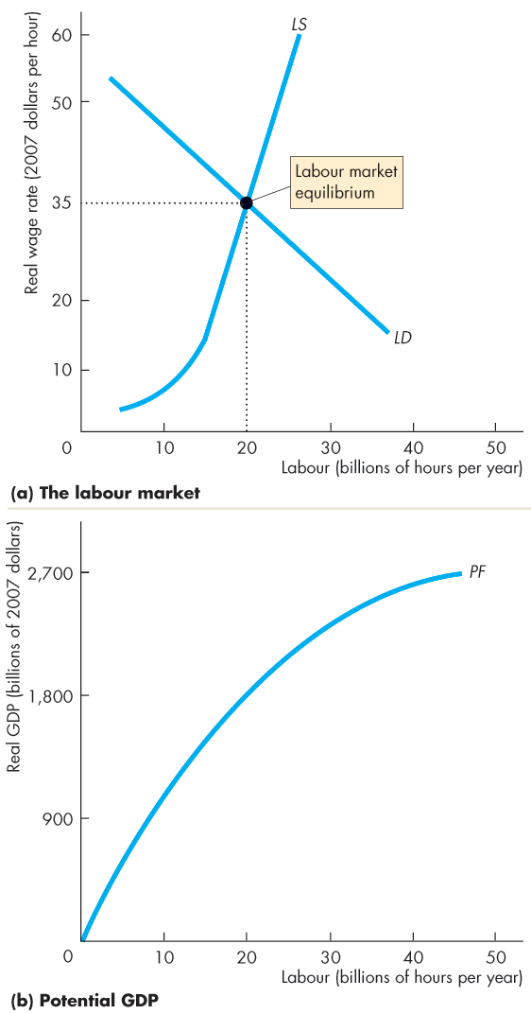
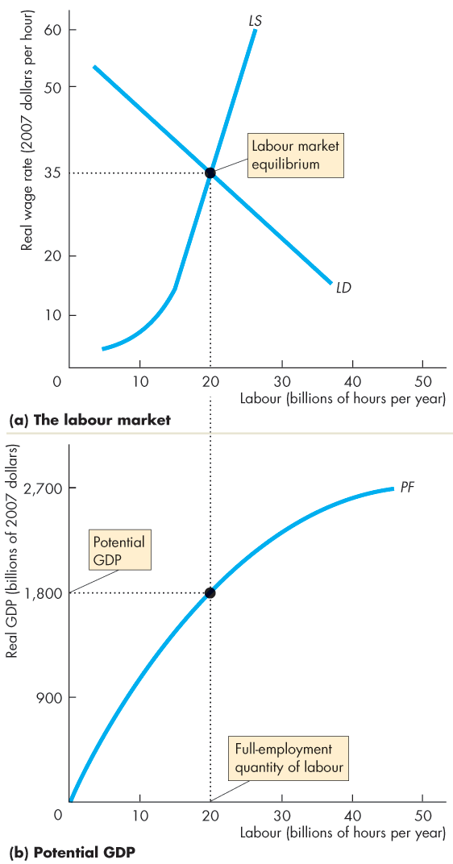
How Potential GDP Grows
Potential GDP
The quantity of real GDP produced when the economy is at full employment is potential GDP.
The economy is at full employment when 20 billion hours of labour are employed.
Potential GDP is $1,800 billion.

Slide 30
How Potential GDP Grows
What Makes Potential GDP Grow?
We begin by dividing real GDP growth into the forces that increase:
Growth in the supply of labour
Growth in labour productivity

Slide 31
How Potential GDP Grows
Growth in the Supply of Labour
Aggregate hours, the total number of hours worked by all the people employed, change as a result of changes in:
1. Average hours per worker
2. Employment-to-population ratio
3. The working-age population growth
Population growth increases aggregate hours and real GDP, but …
to increase real GDP person, labour must become more productive.

Slide 32
How Potential GDP Grows
The Effects of Population Growth
An increase in population increases the supply of labour.
With no change in the demand for labour, the equilibrium real wage rate falls and the aggregate hours increase.
The increase in the aggregate hours increases potential GDP.
Notes:
Is immigration bad for us? Many people think that immigration is bad for existing citizens and lowers their living standard. Part of the popular political discussion, especially in Europe during 2000s, has a racist dimension, which you will want to avoid. But the raw economic dimension is worth examining. When you show your students the effects of an increase in population in Figure 6.9, you will conclude that an increase in population, ceteris paribus, increases real GDP but lowers real GDP per person and lowers the real wage rage. You might then ask: does this outcome mean that immigration is bad for us?
The answer, of course, is absolutely not. Historically, immigrants have brought capital and entrepreneurship, and been some of the most creative sources of technological change. When you combine the effects of capital accumulation and technological change with an increase in population, you see that real GDP increases but the change in the wage rate is ambiguous. Add the historical fact that capital accumulation and technological change have outstripped population growth, and you reach the conclusion that immigration has been (and probably continues to be) a positive economic force.

Slide 33
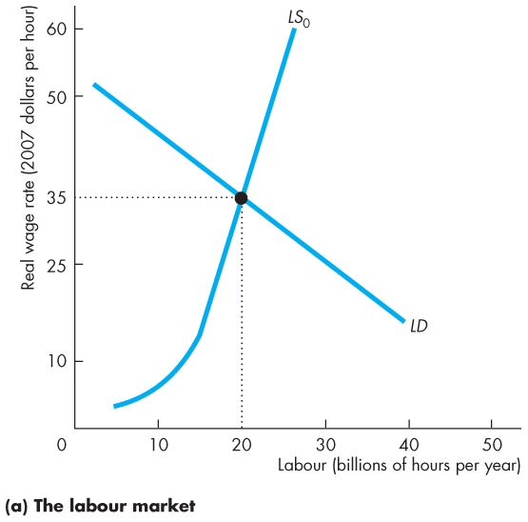
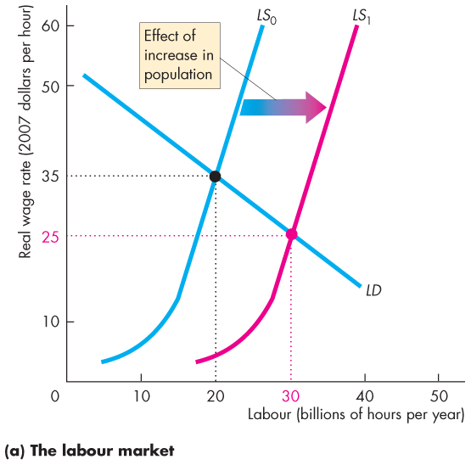
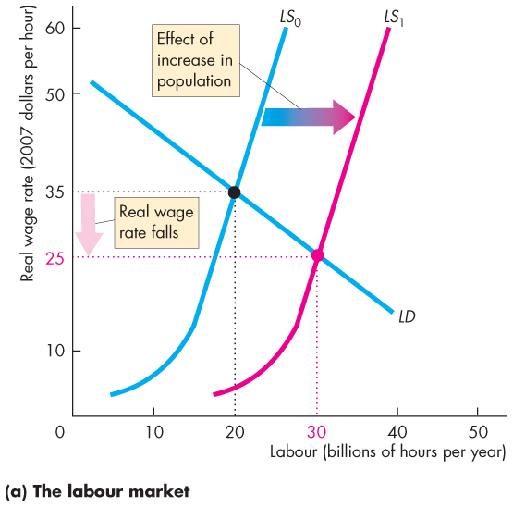
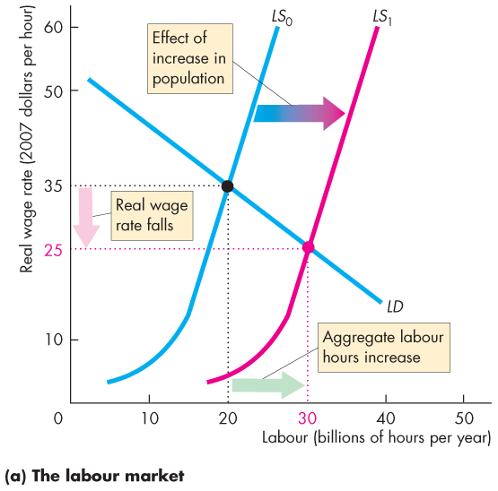
How Potential GDP Grows
Figure 6.9(a) illustrates the effects of population growth in the labour market.
The labour supply curve shifts rightward.
The real wage rate falls …
and aggregate hours increase.

Slide 35
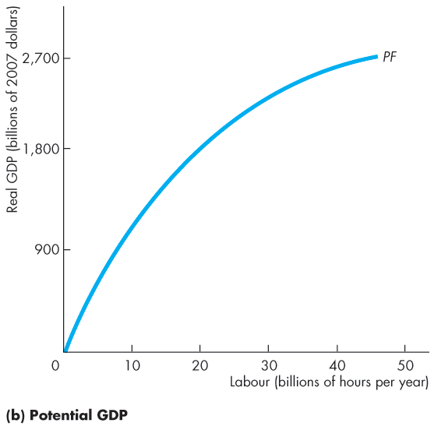
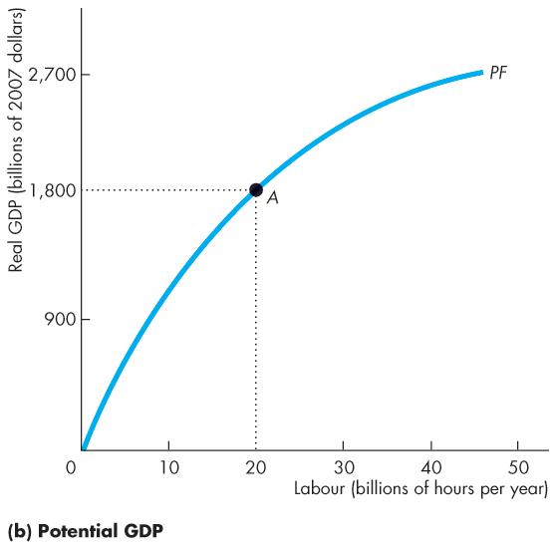
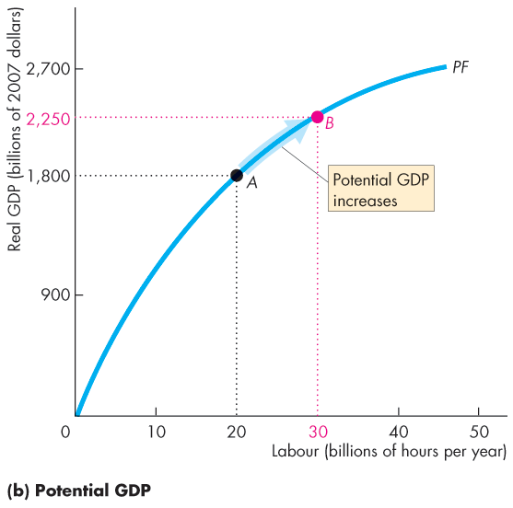
How Potential GDP Grows
The increase in aggregate hours increases potential GDP.
Because the diminishing returns, the increased population …
increases real GDP …
but decreases real GDP per hour of labour.

Slide 37
How Potential GDP Grows
Growth of Labour Productivity
Labour productivity is the quantity of real GDP produced by an hour of labour.
Labour productivity equals real GDP divided by aggregate labour hours.
If labour become more productive, firms are willing to pay more for a given number of hours, so the demand for labour increases.
Notes:
Classroom activity
Check out Economics in the News: Canadian and American Economic Growth

Slide 38
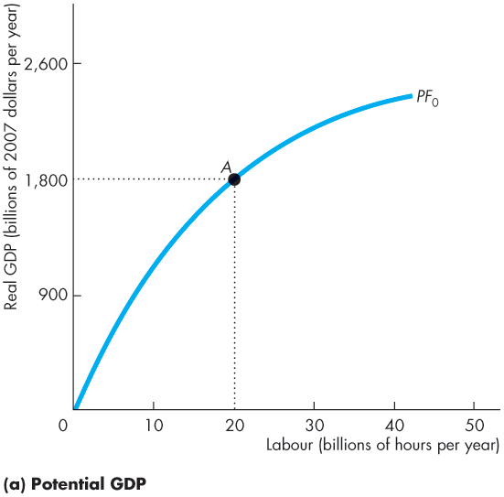
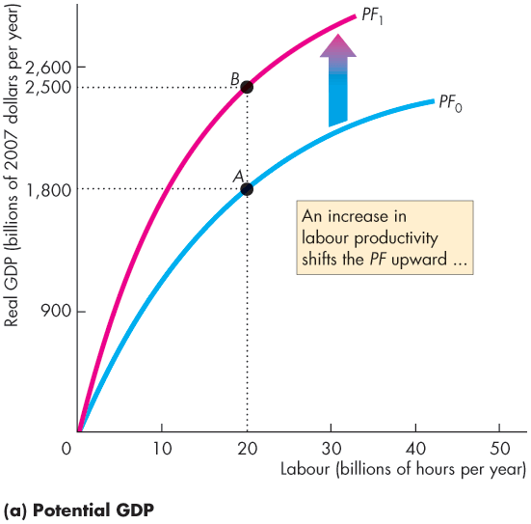
How Potential GDP Grows
Figure 6.10 shows the effect of an increase in labour productivity.
The production function shifts upward.

Slide 39


Slide 40




How Potential GDP Grows
In the labour market:
An increase in labour productivity increases the demand for labour.
With no change in the supply of labour, the real wage rate rises …
and aggregate hours increase.

Slide 42
How Potential GDP Grows
And with the increase in aggregate hours, potential GDP increases.

Slide 43
Why Labour Productivity Grows
Preconditions for Labour Productivity Growth
The fundamental precondition for labour productivity growth is the incentive system created by firms, markets, property rights, and money.
The growth of labour productivity depends on
Physical capital growth
Human capital growth
Technological advances
Notes:
The Causes of Economic Growth: A First Look :The limits of economics. The major obstacles to growth are political, and economists don’t know much about how to remove those political obstacles. You can give your students a glimpse of these obstacles in their worst form by reminding them of news video clips they’ve almost certainly seen of Kabul, Mogadishu, and other troubled cities in which the rule of law has completely broken down.
Economists know a lot about how to make an economy grow if the preconditions are in place, but virtually nothing about how to bring those preconditions about.
The preconditions. The three preconditions for growth—markets, property rights, and monetary exchange—are all essential to create acceptable levels of risk and low enough transaction costs to justify investment, specialization,
and exchange. If you want to spend time on it, you can generate an interesting discussion on whether what matters is the particular system of property rights, or just that they be clear, certain, and enforceable with reasonable cost—the concept of the rule of law. Most students have never realized that property rights are highly varied, and many fast growing economies have nothing like Canada’s absolute property rights in land, for example.

Slide 44
Why Labour Productivity Grows
Physical Capital Growth
The accumulation of new capital increases capital per worker and increases labour productivity.
Human Capital Growth
Human capital acquired through education, on-the-job training, and learning-by-doing is the most fundamental source of labour productivity growth.

Slide 45
Why Labour Productivity Grows
Technological Advances
Technological change—the discovery and the application of new technologies and new goods—has contributed immensely to increasing labour productivity.
Figure 6.11 on the next slide summarizes the process of growth.
It also shows that the growth of real GDP per person depends on real GDP growth and the population growth rate.
Notes:
Classroom activity
Check out Economics in Action: Intellectual Property Rights Propel Growth
Check out Economics in the News: Robots as Skilled Workers

Slide 46




Why Labour Productivity Grows
Notes:
Interactions of sources of growth. Most students can see immediately how investment in physical and human capital in the form of education and training contribute to growth. Some have more difficulty getting a clear view of the role of learning by doing and technical change, particularly the small continuous refinement and improvement to existing technology rather than the spectacular breakthroughs. Much growth probably comes from the interaction of the last two, and this source of growth can be illustrated with a discussion of why firms offer incentives to workers to suggest improvements to working methods and procedures.
Classroom activity
Check out Economics in Action: The Source of Canada’s Economic Slowdown

Slide 48
Is Economic Growth Sustainable? Theories, Evidence, and Policies
We study three growth theories:
Classical growth theory
Neoclassical growth theory
New growth theory
Classical Growth Theory
Classical growth theory is the view that the growth of real GDP per person is temporary and that when it rises above the subsistence level, a population explosion eventually brings real GDP per person back to the subsistence level.
Notes:
Historical development of theories and an aside. The three growth theories studied in this chapter—classical, neoclassical, and new—are presented in historical order. Point out this fact to the students to emphasize and illustrate how economic theory builds on itself. (An aside for you, not your students: Note that the chapter skips the Keynesian era Harrod-Domar model. The main reason for this omission is that these models were quickly shown to be in error and never formed the basis of a seriously proposed growth theory. Based on fixed coefficients and fixed saving rates, the Harrod-Domar model produces either secular stagnation or secular inflation. Neither phenomenon occurs in real economies. Solow’s neoclassical model was developed, historically, to show the error of the Harrod-Domar model, but the neoclassical model also builds naturally on its classical predecessor, and that is the sequence in the textbook.)
Classical theory. Start with the classical theory. The classical theory of growth takes technological change as exogenous, essentially ignores the role of capital (as a result of the era in which it was developed), and assumes that population growth increases when income increases (also as a result of the era in which it was developed). As a result, the conclusions from the classical theory are “dismal” indeed! Some students find it interesting to know that Thomas Malthus, most closely associated with the population part of this theory, was a clergyman, but was also the first person in the Anglophone world to hold the title of Professor of Political Economy (at the East India College). Economists came to realize that capital accumulation and technological change were important parts of the growth process. They also came to understand that population growth does not necessarily increase with income. Hence the stage was set for the neoclassical theory.

Slide 49
Is Economic Growth Sustainable? Theories, Evidence, and Policies
Modern-Day Malthusians
Many people today are Malthusians.
They say that if today’s global population of 7.2 billion explodes to 11 billion by 2050 and perhaps 35 billion by 2300, we will run out of resources, …
real GDP per person will decline and we will return to a primitive standard of living.
We must, say Malthusians, contain population growth.
Notes:
Classical growth theory is based on the work of Thomas Malthus, an economist from the early nineteenth century.
Very few modern-day economists would refer to themselves as Malthusians. But, as the textbook says, there are many other people today who are Malthusians. The persistence of this viewpoint represents what one can only refer to as the triumph of despair over experience. At some point in history, Malthusian theory might have been applicable. But certainly since the industrial revolution, parents have chosen to concentrate on the quality of children not the quantity. And this shift in emphasis only gets stronger as economic growth advances. Thus, the assumption that the population growth rate is primarily determined by economic growth with a positive relationship has no basis in reality. Indeed, some of the richest countries in the world, such as Sweden and Japan, have some of the lowest birth rates.

Slide 50
Is Economic Growth Sustainable? Theories, Evidence, and Policies
As the population increases the real wage rate falls.
The population continues to grow until the real wage rate has been driven back to the subsistence real wage rate.
At this real wage rate, both population growth and economic growth stop.
Contrary to the assumption of the classical theory, the historical evidence is that population growth rate is not tightly linked to income per person, and population growth does not drive incomes back down to subsistence levels.

Slide 51
Is Economic Growth Sustainable? Theories, Evidence, and Policies
Neoclassical Growth Theory
Neoclassical growth theory is the proposition that real GDP per person grows because technological change induces a level of saving and investment that makes capital per hour of labour grow.
Growth ends only if technological change stops because of diminishing marginal returns to both labour and capital.
Notes:
Neoclassical theory. Neoclassical theory follows the classical theory by taking technological growth as exogenous. It differs insofar as it assumes that population growth is also exogenous. The major difference is that neoclassical theory stresses the role played by technological change and how it influences saving and capital accumulation. So of the two differences between neoclassical and classical growth theory, the first—the different assumptions about how population growth is determined—reflects an advance in empirical knowledge of the relationship between population growth and income. The second difference—the importance given to technological change, saving, and capital—shows how the neoclassical theory built on the simpler classical model.

Slide 52
Is Economic Growth Sustainable? Theories, Evidence, and Policies
The Neoclassical Theory of Population Growth
The neoclassical view is that the population growth rate is independent of real GDP and the real GDP growth rate.
Technological Change and Diminishing Returns
In the neoclassical theory, the rate of technological change influences the economic growth rate but economic growth does not influence the pace of technological change.
It is assumed that technological change results from chance.

Slide 53
Is Economic Growth Sustainable? Theories, Evidence, and Policies
The Basic Neoclassical Idea
Technology begins to advance at a more rapid pace.
New profit opportunities arise and investment and saving increase.
As technology advances and the capital stock grows, real GDP per person increases.
Diminishing returns to capital lower the real interest rate and eventually economic growth slows and just keeps up with population growth.
Capital per worker remains constant.

Slide 54
Is Economic Growth Sustainable? Theories, Evidence, and Policies
A Problem with Neoclassical Growth Theory
All economies have access to the same technologies and capital is free to roam the globe, seeking the highest available real interest rate.
These facts imply that economic growth rates and real GDP per person across economies will converge.
Figure 6.5 shows some convergence among rich countries, but convergence doesn’t appear imminent for all countries.

Slide 55
Is Economic Growth Sustainable? Theories, Evidence, and Policies
New Growth Theory
New growth theory holds that real GDP per person grows because of choices that people make in the pursuit of profit and that growth can persist indefinitely.
The theory begins with two facts about market economies:
Discoveries result from choices.
Discoveries bring profit and competition destroys profit.
Notes:
New growth theory. Neoclassical theory also is incomplete because the primary engine of economic growth, technology, is exogenous. New growth theory attempts to overcome this weakness. It still uses many of the insights of the neoclassical theory by emphasizing the role of capital accumulation and assuming that population growth is exogenous. But the new growth theory builds on neoclassical theory by examining more closely the role of technology and the factors that influence technological advances.
Giving the students this type of broad overview before presenting the details of the different models is important because it, along with the text’s outstanding overview, allows the students to see the forest as well as the trees. This knowledge not only helps them understand the particular models, but it also helps them gain an appreciation of how economics progresses. (Of course, progress is hardly as steady as the students might believe; for instance, Pigou and Ramsey presented important papers about growth in the early part of the twentieth century, but, nonetheless, progress has been made.)

Slide 56
Is Economic Growth Sustainable? Theories, Evidence, and Policies
Two further facts play a key role in the new growth theory:
Discoveries are a public capital good.
Knowledge is not subject to diminishing returns.
Increasing the stock of knowledge makes capital and labour more productive.
Knowledge capital does not experience diminishing returns is the central proposition of new growth theory.

Slide 57








Is Economic Growth Sustainable? Theories, Evidence, and Policies
Figure 6.12 summarizes the ideas of new growth theory as a perpetual motion machine.

Slide 59
Is Economic Growth Sustainable? Theories, Evidence, and Policies
Sorting Out the Theories
Each theory teaches us something of value but not the whole story.
Classical theory reminds us that our physical resources are limited and we need technological advances to grow.
Neoclassical theory emphasizes diminishing returns to capital which means we need technological advances to grow.
New theory emphasizes the capacity of human resources to innovate at a pace that offsets diminishing returns.

Slide 60
Is Economic Growth Sustainable? Theories, Evidence, and Policies
The Empirical Evidence on the Causes of Economic Growth
Economic growth makes progress through the interplay of theory and empirical evidence.
Theory makes predictions about what we will observe if it is correct.
Empirical evidence provides the data for testing the theory.
Table 6.1 on the next slide summarizes the more robust influences on growth that economists have discovered.

Slide 61

Is Economic Growth Sustainable? Theories, Evidence, and Policies

Slide 62
Is Economic Growth Sustainable? Theories, Evidence, and Policies
Policies for Achieving Faster Growth
Growth accounting tell us that to achieve faster economic growth we must either increase the growth rate of capital per hour of labour or increase the pace of technological change.
The main suggestions for achieving these objectives are
Stimulate Saving
Saving finances investment. So higher saving rates might increase physical capital growth.
Tax incentives might be provided to boost saving.
Notes:
Achieving faster growth. Policies to promote growth can generate interesting and useful discussion. For example, it is investment that produces growth, and in the previous chapter we showed that investment does not depend on private saving alone. Is it appropriate then to stimulate private saving artificially? Similarly, the arguments for subsidizing research and development and education are both based on public good aspects of those activities, but what form and extent should subsidies take?
Why the Luddites were wrong. This chapter provides you with a wonderful opportunity to explain to your students why the Luddites were wrong—and why the modern neo-Luddite movement is wrong. You can learn more than you need to know about Luddism and the Luddites, ancient and modern, at http://carbon.cudenver.edu/~mryder/itc_data/luddite.html
You might then spend a few minutes agreeing that capital accumulation and technological change decrease the demand for the labour that the new capital replaces. But it increases the demand for other types of labour—complementary labour. People must acquire more skill—some people learn to work with the new capital, some learn how to maintain it in good condition, some learn how to build it, some learn how to market and sell it, some learn to design new ways of using it, some work on thinking up new goods and services to produce with it, and so on. All of these people are more productive that they were before.

Slide 63
Is Economic Growth Sustainable? Theories, Evidence, and Policies
Stimulate Research and Development
Because the fruits of basic research and development efforts can be used by everyone, not all the benefit of a discovery falls to the initial discoverer.
So the market might allocate too few resources to research and development.
Government subsidies and direct funding might stimulate basic research and development.
Notes:
New technologies that create new products have even more obvious effects on productivity. The development of the CD in the early 1980s is a good example. Suddenly thousands of people became very productive converting the heritage of recorded music into digital format, cleaning up the sound, and making and selling millions of CDs. The same type of thing is now happening with the DVD and Blu-ray.

Slide 64
Is Economic Growth Sustainable? Theories, Evidence, and Policies
Improve the Quality of Education
The benefits from education spread beyond the person being educated, so there is a tendency to under invest in education.
Provide International Aid to Developing Countries
If rich countries give financial aid to developing countries, investment and growth will increase.
But data on the effect of aid shows that it has had zero or a negative effect.

Slide 65
Is Economic Growth Sustainable? Theories, Evidence, and Policies
Encourage International Trade
Free international trade stimulates growth by extracting all the available gains from specialization and trade.
The fastest growing nations are the ones with the fastest growing exports and imports.

